Slide 1


Home Credit Default Risk
Sumeyra Bharuchi
Zahra Weiser
Rukayat
Sana
Feeza Sikander

Slide 2


Slide 3

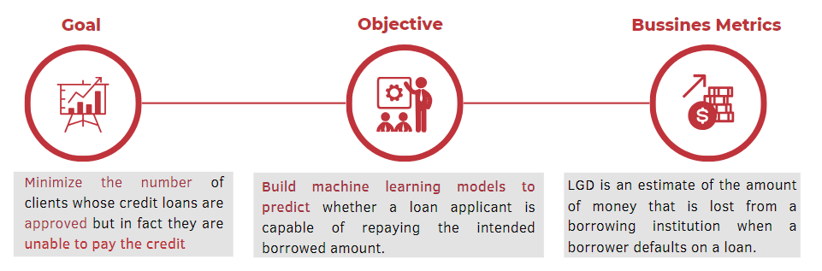

Slide 4
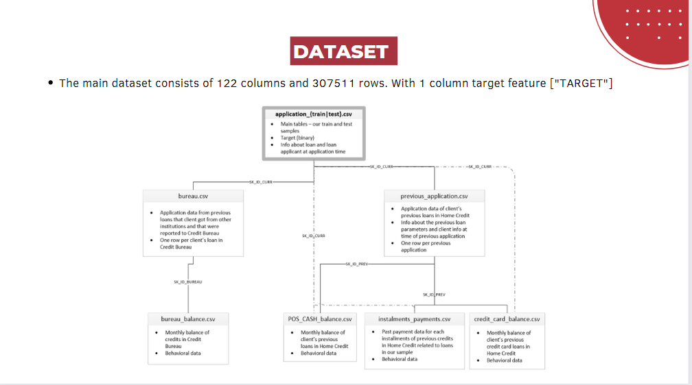
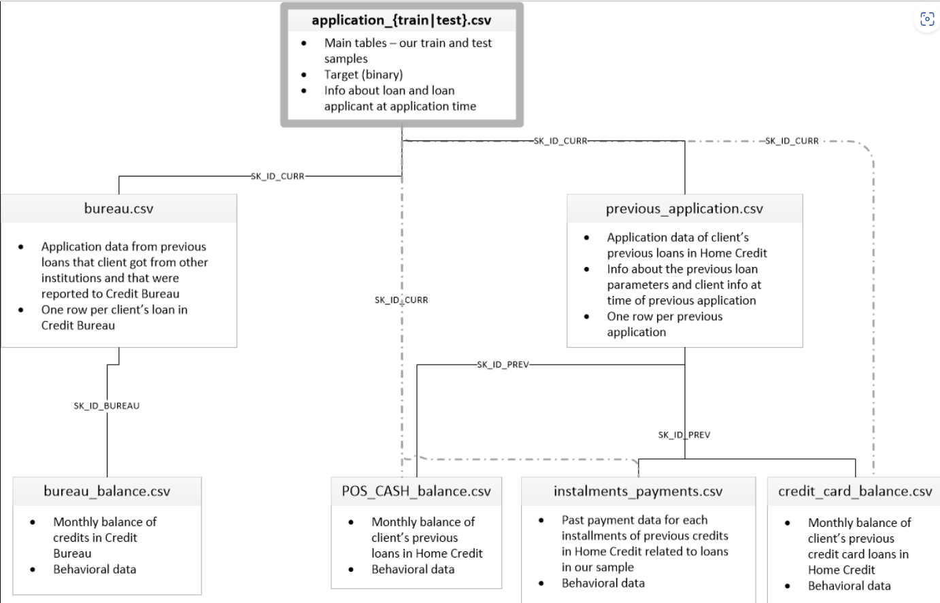

Slide 5
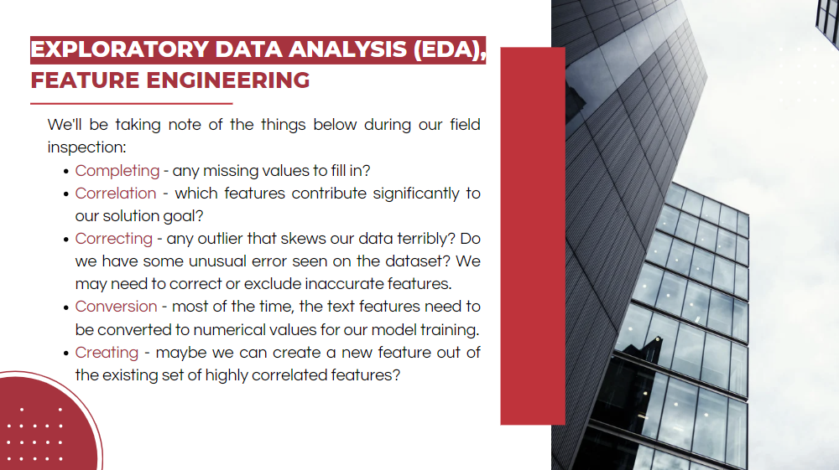
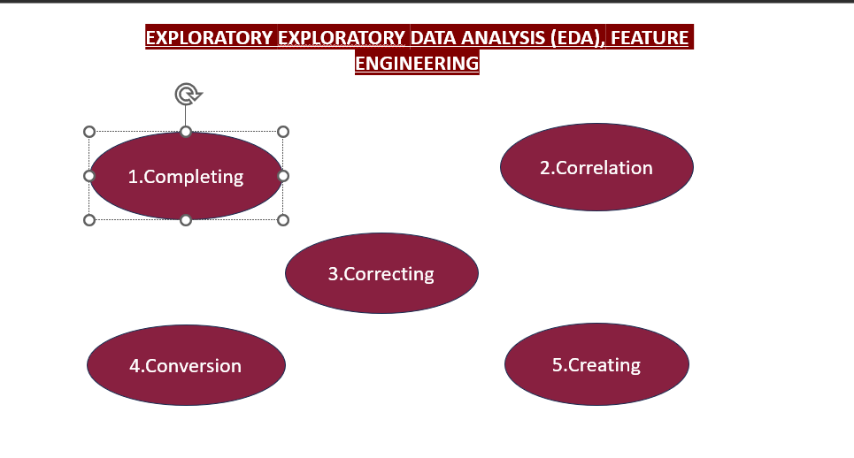

Slide 6
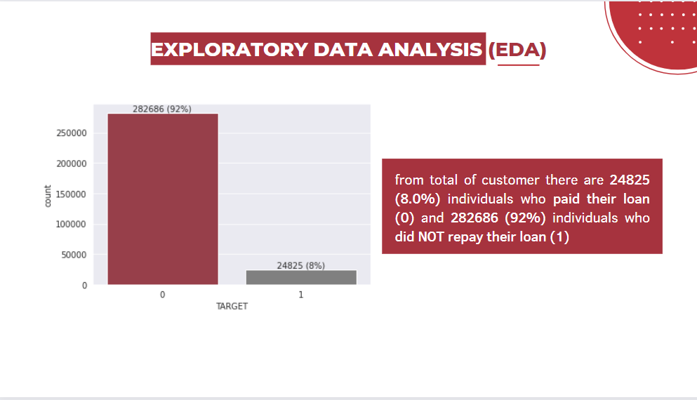

Slide 7
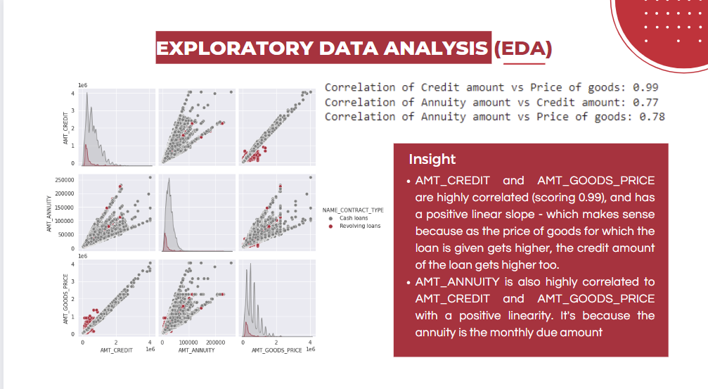

Slide 8
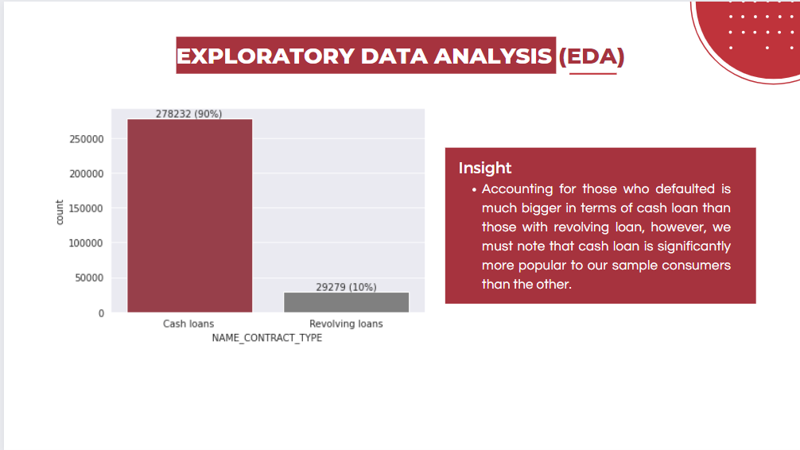

Slide 9
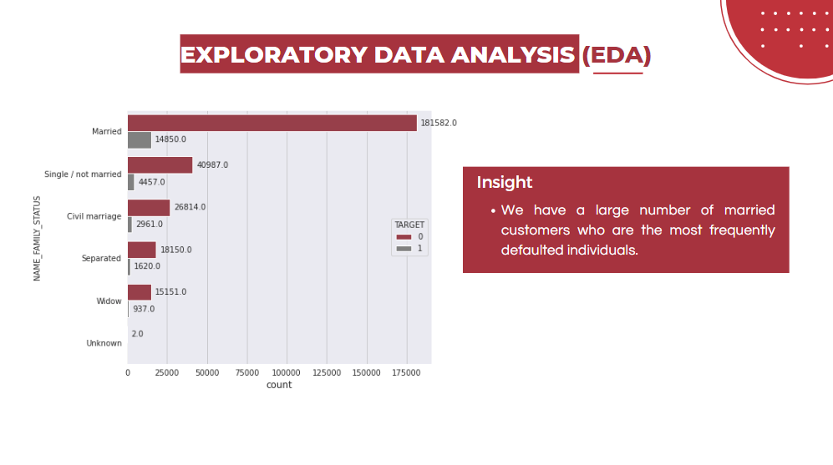

Slide 10
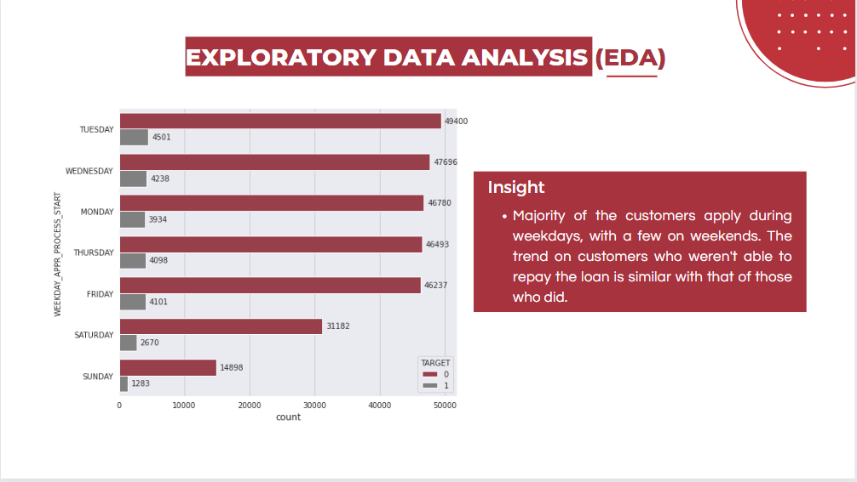

Slide 11
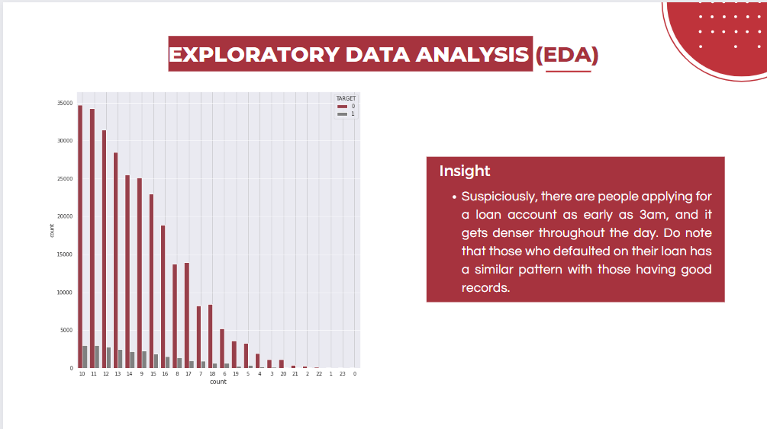

Slide 12
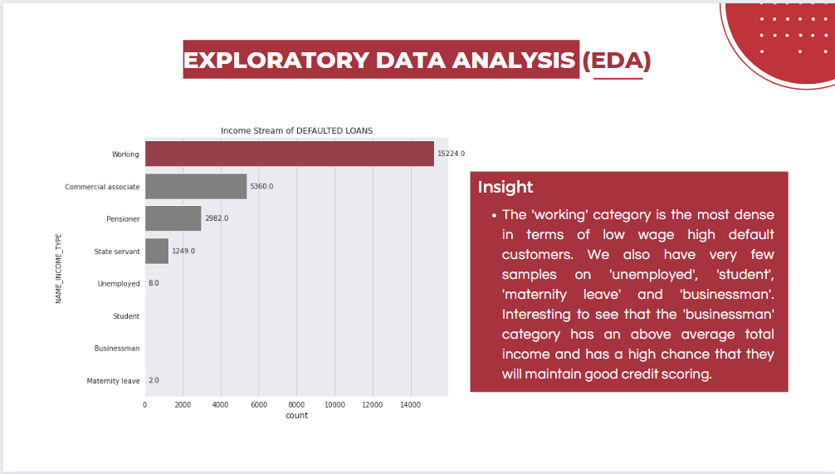

Slide 13
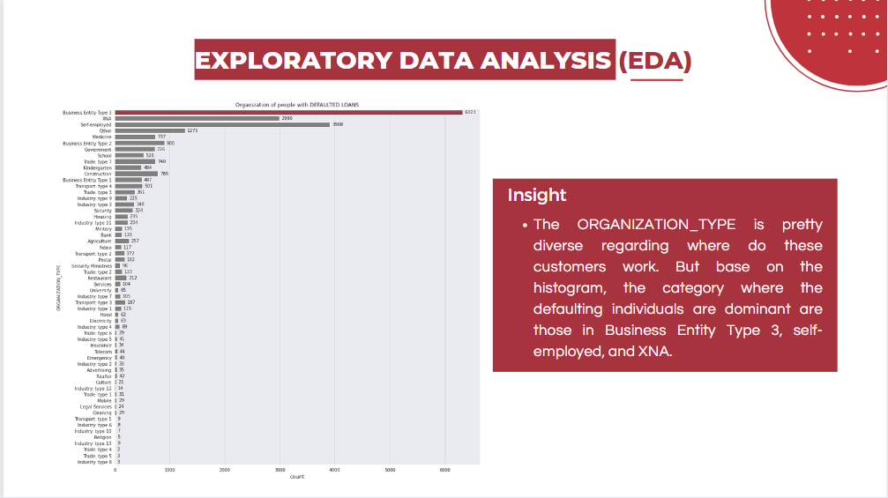

Slide 14
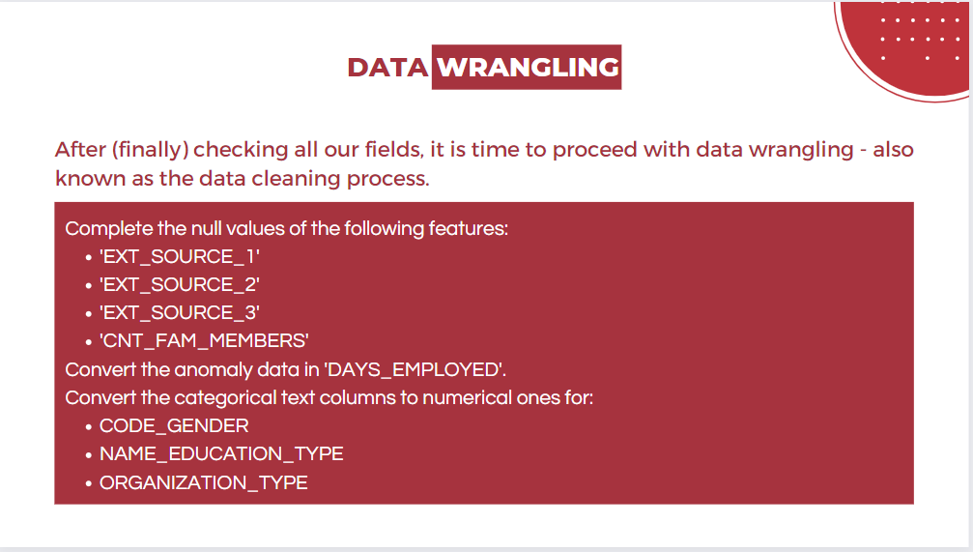

Slide 15


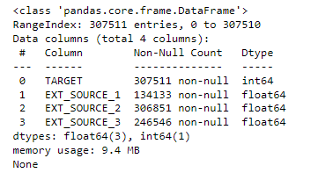
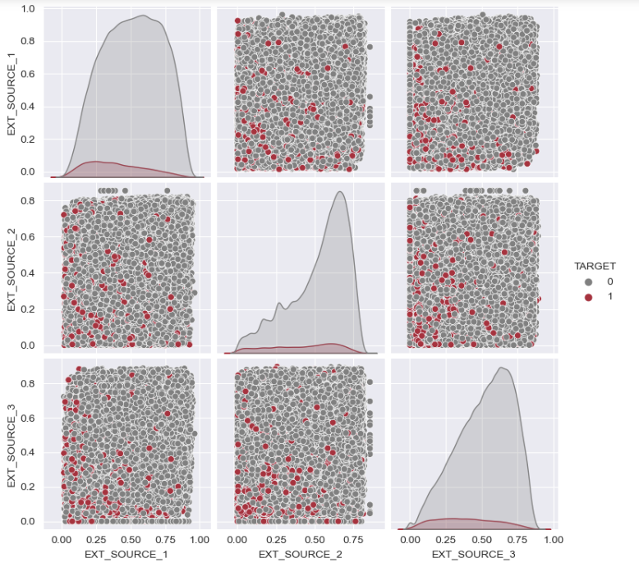
Observations:
These 3 fields are external data source score fields.
Base on the plot, those who were able to pay and did not pay can have scores fairly distributed on EXT_SOURCE fields, but it is quite evident that on the lower end of the normalized score mark (0.0-0.5), customers who paid (target=0, grey color) are much less prominent than those who didn't (target=1, red color)... and vice versa.
All 3 fields have missing values.

Slide 16


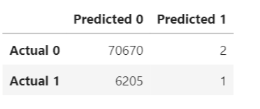
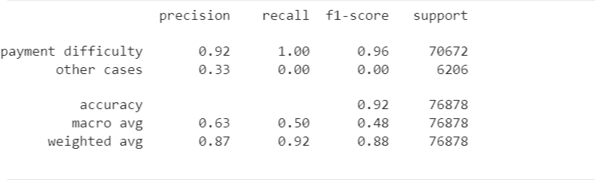

Slide 17

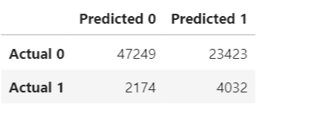
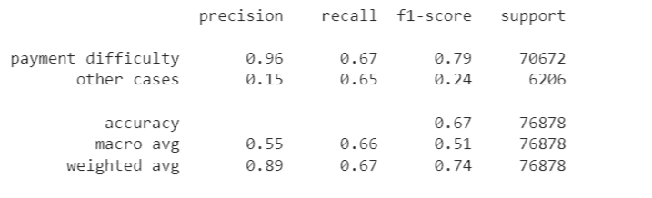
Logistic Regression
Resampled training data

Slide 18


Defaulting on your Home Credit payments can lead to serious risks and problems, including receiving terrorizing phone calls from debt collectors and even the risk of running away from your installments. However, if you’re having trouble paying your installments, don’t worry because there are solutions. As a customer, make sure you understand all the terms and conditions in your loan agreement to avoid unnecessary fees. Don’t be too hasty in choosing the loan amount you take and make sure you are able to pay the installments on time and regularly. This way, you can minimize the risks and problems of taking out a loan with Home Credit Indonesia.

